Slide 1
Chapter 4 Threads
Operating Systems: Internals and Design Principles
By William Stallings
Notes:
“Operating Systems: Internal and Design Principles”, 8/e, by William Stallings, Chapter 4 “Threads”.

Slide 2
Chapter 4
Core
Examples
Processes and threads
Multithreading
Thread functionality
Multicore and multithreading
Types of threads
User level and kernel level threads
Solaris thread and SMP management
Multithreaded architecture
Motivation
Process structure
Thread execution
Interrupts as threads
Linux process and thread management
Tasks/threads/namespaces
Mac OS X grand central dispatch
Notes:
Chapter 4 summary.

Slide 3
Processes…
Resource Ownership
Scheduling/Execution
Process includes a virtual address space to hold the process image
the OS performs a protection function to prevent unwanted interference between processes with respect to resources
Follows an execution path that may be interleaved with other processes
a process has an execution state (Running, Ready, etc.) and a dispatching priority and is scheduled and dispatched by the OS
Notes:
The discussion so far has presented the concept of a process as embodying two
characteristics:
• Resource ownership: A process includes a virtual address space to hold the
process image; recall from Chapter 3 that the process image is the collection of
program, data, stack, and attributes defined in the process control block. From
time to time, a process may be allocated control or ownership of resources,
such as main memory, I/O channels, I/O devices, and files. The OS performs a
protection function to prevent unwanted interference between processes with
respect to resources.
• Scheduling/execution: The execution of a process follows an execution path
(trace) through one or more programs (e.g., Figure 1.5). This execution may
be interleaved with that of other processes. Thus, a process has an execution
state (Running, Ready, etc.) and a dispatching priority and is the entity that is
scheduled and dispatched by the OS.

Slide 4
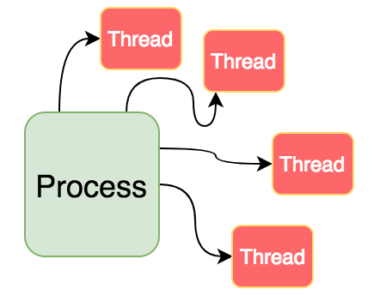
Processes and Threads
The unit of dispatching is referred to as a thread or lightweight process
The unit of resource ownership is referred to as a process or task
Multithreading - The ability of an OS to support multiple, concurrent paths of execution within a single process
All threads of a program are logically contained within a process.
A process is heavy weighted, but a thread is light weighted.
A program is an isolated execution unit whereas thread is not isolated and shares memory.
A thread cannot have an individual existence; it is attached to a process. On the other hand, a process can exist individually.
At the time of expiration of a thread, its associated stack could be recovered as every thread has its own stack. In contrast, if a process dies, all die including the process.
Notes:
To distinguish the two characteristics, the unit of dispatching is usually referred to as a thread or lightweight process , while the unit of resource ownership is usually referred to as a process or task .
Multithreading refers to the ability of an OS to support multiple, concurrent paths of execution within a single process.

Slide 5
Processes vs. Threads
BASIS FOR COMPARISON | PROCESS | THREAD
Basic | Program in execution. | Lightweight process or part of it.
Memory sharing | Completely isolated and do not share memory. | Shares memory with each other.
Resource consumption | More | Less
Efficiency | Less efficient as compared to the process in the context of communication. | Enhances efficiency in the context of communication.
Time required for creation | More | Less
Context switching time | Takes more time. | Consumes less time.
Uncertain termination | Results in loss of process. | A thread can be reclaimed.
Time required for termination | More | Less
Notes:
To distinguish the two characteristics, the unit of dispatching is usually referred to as a thread or lightweight process , while the unit of resource ownership is usually referred to as a process or task .
Multithreading refers to the ability of an OS to support multiple, concurrent paths of execution within a single process.

Slide 6
Single Threaded Approaches
A single thread of execution per process, in which the concept of a thread is not recognized, is referred to as a single-threaded approach
MS-DOS is an example
Notes:
The traditional approach of a single thread of execution per process, in which the concept of a thread is not recognized, is referred to as a single-threaded approach. The two arrangements shown in the left half of Figure 4.1 are single-threaded approaches. MS-DOS is an example of an OS that supports a single user process and a single thread.

Slide 7
Multithreaded Approaches
The right half of Figure 4.1 depicts multithreaded approaches
A Java run-time environment is an example of a system of one process with multiple threads
Modern OSs: Multiple processes, multiple threads

Slide 8
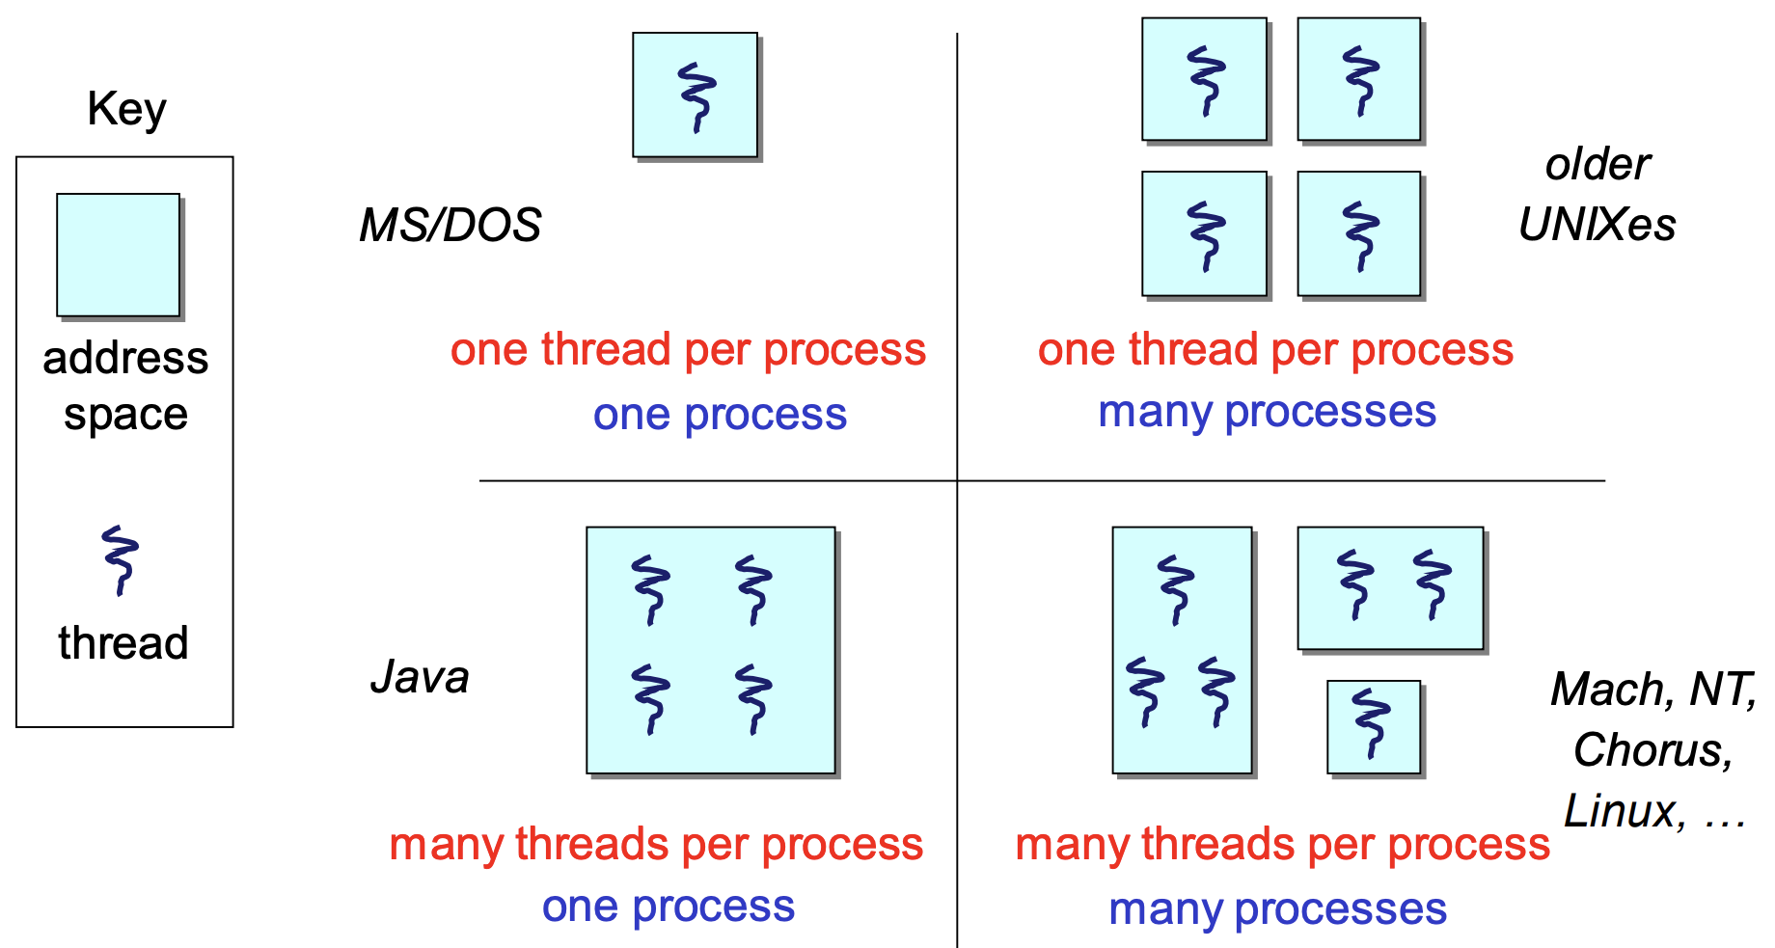
Classifying Threaded Systems
Operating Systems can support one or many address spaces, and one or many threads per address space.
Notes:
address spaces?
The right half of Figure 4.1 depicts multithreaded approaches. A Java run-time environment is an example of a system of one process with multiple threads. Of interest in this section is the use of multiple processes, each of which supports multiple threads. This approach is taken in Windows, Solaris, and many modern versions of UNIX, among others. In this section we give a general description of multithreading; the details of the Windows, Solaris, and Linux approaches are discussed later in this chapter.
A Java run-time environment is an example of a system of one process with multiple threads
Modern OSs: Multiple processes, multiple threads

Slide 9
Processes
The unit or resource allocation and a unit of protection
A virtual address space that holds the process image
Protected access to:
processors
other processes
files
I/O resources
Notes:
In a multithreaded environment, a process is defined as the unit of resource allocation and a unit of protection. The following are associated with processes:
• A virtual address space that holds the process image
• Protected access to processors, other processes (for interprocess communication), files, and I/O resources (devices and channels)

Slide 10
One or More Threads in a Process
Each thread has:
an execution state (Running, Ready, etc.)
saved thread context when not running
an execution stack
some per-thread static storage for local variables
access to the memory and resources of its process (all threads of a process share this)
Notes:
Within a process, there may be one or more threads, each with the following:
• A thread execution state (Running, Ready, etc.)
• A saved thread context when not running; one way to view a thread is as an independent program counter operating within a process
• An execution stack
• Some per-thread static storage for local variables
• Access to the memory and resources of its process, shared with all other threads in that process

Slide 11
Notes:
Figure 4.2 illustrates the distinction between threads and processes from the point of view of process management. In a single-threaded process model (i.e., there is no distinct concept of thread), the representation of a process includes its process control block and user address space, as well as user and kernel stacks to manage the call/return behavior of the execution of the process. While the process is running, it controls the processor registers. The contents of these registers are saved when the process is not running. In a multithreaded environment, there is still a single process control block and user address space associated with the process, but now there are separate stacks for each thread, as well as a separate control block for each thread containing register values, priority, and other thread-related state information.

Slide 12
Benefits of Threads
Takes less time to create a new thread than a process
Less time to terminate a thread than a process
Switching between two threads takes less time than switching between processes
Threads enhance efficiency in communication between programs
Notes:
Thus, all of the threads of a process share the state and resources of that process. They reside in the same address space and have access to the same data. When one thread alters an item of data in memory, other threads see the results if and when they access that item. If one thread opens a file with read privileges, other threads in the same process can also read from that file.
The key benefits of threads derive from the performance implications:
1. It takes far less time to create a new thread in an existing process than to
create a brand-new process. Studies done by the Mach developers show that
thread creation is ten times faster than process creation in UNIX [TEVA87].
2. It takes less time to terminate a thread than a process.
3. It takes less time to switch between two threads within the same process than to switch between processes.
4. Threads enhance efficiency in communication between different executing programs. In most operating systems, communication between independent processes requires the intervention of the kernel to provide protection and the mechanisms needed for communication. However, because threads within the same process share memory and files, they can communicate with each other without invoking the kernel.
Thus, if there is an application or function that should be implemented as a set of related units of execution, it is far more efficient to do so as a collection of threads rather than a collection of separate processes.

Slide 13
Thread Use in a Single-User System
Foreground and background work
Asynchronous processing
Speed of execution
Modular program structure
Notes:
[LETW88] gives four examples of the uses of threads in a single-user multiprocessing system:
• Foreground and background work: For example, in a spreadsheet program,
one thread could display menus and read user input, while another thread executes user commands and updates the spreadsheet. This arrangement often increases the perceived speed of the application by allowing the program to prompt for the next command before the previous command is complete.
• Asynchronous processing: Asynchronous elements in the program can be
implemented as threads. For example, as a protection against power failure, one can design a word processor to write its random access memory (RAM) buffer to disk once every minute. A thread can be created whose sole job is periodic backup and that schedules itself directly with the OS; there is no need for fancy code in the main program to provide for time checks or to coordinate input and output.
• Speed of execution: A multithreaded process can compute one batch of data
while reading the next batch from a device. On a multiprocessor system, multiple threads from the same process may be able to execute simultaneously. Thus, even though one thread may be blocked for an I/O operation to read in a batch of data, another thread may be executing.
• Modular program structure: Programs that involve a variety of activities or a
variety of sources and destinations of input and output may be easier to design and implement using threads.

Slide 14
Threads
Most of the state information dealing with execution is maintained in thread-level data structures
In an OS that supports threads, scheduling and dispatching is done on a thread basis
suspending a process involves suspending all threads of the process
termination of a process terminates all threads within the process
Notes:
In an OS that supports threads, scheduling and dispatching is done on a thread basis; hence, most of the state information dealing with execution is maintained in thread-level data structures. There are, however, several actions that affect all of the threads in a process and that the OS must manage at the process level. For example, suspension involves swapping the address space of one process out of main memory to make room for the address space of another process. Because all threads in a process share the same address space, all threads are suspended at the same time. Similarly, termination of a process terminates all threads within that process.

Slide 15
Thread Execution States
The key states for a thread are:
Running
Ready
Blocked
Thread operations associated with a change in thread state are:
Spawn
Block
Unblock
Finish
Notes:
As with processes, the key states for a thread are Running, Ready, and Blocked. Generally, it does not make sense to associate suspend states with threads because such states are process-level concepts. In particular, if a process is swapped out, all of its threads are necessarily swapped out because they all share the address space of the process. There are four basic thread operations associated with a change in thread state [ANDE04]:
• Spawn: Typically, when a new process is spawned, a thread for that process is also spawned. Subsequently, a thread within a process may spawn
another thread within the same process, providing an instruction pointer and arguments for the new thread. The new thread is provided with its own register context and stack space and placed on the ready queue.
• Block: When a thread needs to wait for an event, it will block (saving its user registers, program counter, and stack pointers). The processor may now turn to the execution of another ready thread in the same or a different process.
• Unblock: When the event for which a thread is blocked occurs, the thread is moved to the Ready queue.
• Finish: When a thread completes, its register context and stacks are deallocated.

Slide 16
A
B
A
B
Notes:
A significant issue is whether the blocking of a thread results in the blocking of the entire process. In other words, if one thread in a process is blocked, does this prevent the running of any other thread in the same process even if that other thread is in a ready state? Clearly, some of the flexibility and power of threads is lost if the one blocked thread blocks an entire process.
We return to this issue subsequently in our discussion of user-level versus kernel-level threads, but for now let us consider the performance benefits of threads that do not block an entire process. Figure 4.3 (based on one in [KLEI96]) shows a program that performs two remote procedure calls (RPCs) to two different hosts to obtain a combined result. In a single-threaded program, the results are obtained in sequence, so the program has to wait for a response from each server in turn. Rewriting the program to use a separate thread for each RPC results in a substantial speedup. Note that if this program operates on a uniprocessor, the requests must be generated sequentially and the results processed in sequence; however, the program waits concurrently for the two replies.

Slide 17
Notes:
On a uniprocessor, multiprogramming enables the interleaving of multiple
threads within multiple processes. In the example of Figure 4.4, three threads in
two processes are interleaved on the processor. Execution passes from one thread
to another either when the currently running thread is blocked or when its time slice
is exhausted.

Slide 18
Thread Synchronization
It is necessary to synchronize the activities of the various threads
all threads of a process share the same address space and other resources
any alteration of a resource by one thread affects the other threads in the same process
Notes:
All of the threads of a process share the same address space and other resources, such as open files. Any alteration of a resource by one thread affects the environment of the other threads in the same process. It is therefore necessary to synchronize the activities of the various threads so that they do not interfere with each other or corrupt data structures. For example, if two threads each try to add an element to a doubly linked list at the same time, one element may be lost or the list may end up malformed. The issues raised and the techniques used in the synchronization of threads are, in general, the same as for the synchronization of processes. These issues and techniques are the subject of Chapters 5 and 6 .

Slide 19
Table 4.2
Relationship between Threads and Processes
Notes:
As we have said, the concepts of resource allocation and dispatching unit have traditionally been embodied in the single concept of the process—that is, as a 1 : 1 relationship between threads and processes. Recently, there has been much interest in providing for multiple threads within a single process, which is a many-to-one relationship. However, as Table 4.2 shows, the other two combinations have also been investigated, namely, a many-to-many relationship and a one-to-many relationship.
The idea of having a many-to-many relationship between threads and processes has been explored in the experimental operating system TRIX [PAZZ92, WARD80]. In TRIX, there are the concepts of domain and thread. A domain is a static entity, consisting of an address space and “ports” through which messages may be sent and received. A thread is a single execution path, with an execution stack, processor state, and scheduling information.
As with the multithreading approaches discussed so far, multiple threads may execute in a single domain, providing the efficiency gains discussed earlier. However, it is also possible for a single user activity, or application, to be performed in multiple domains. In this case, a thread exists that can move from one domain to another.

Slide 20
Chapter 4
Processes and threads
Multithreading
Thread functionality
Multicore and multithreading
Types of threads
User level and kernel level threads
Solaris thread and SMP management
Multithreaded architecture
Motivation
Process structure
Thread execution
Interrupts as threads
Linux process and thread management
Tasks/threads/namespaces
Mac OS X grand central dispatch
Notes:
Chapter 4 summary.

Slide 21
Applications that can benefit from multi-core scaling
Multithreaded native applications
characterized by having a small number of highly threaded processes
Multiprocess applications
characterized by the presence of many single-threaded processes
Multi-instance applications
multiple instances of the application in parallel
Notes:
In addition to general-purpose server software, a number of classes of applications benefit directly from the ability to scale throughput with the number of cores. [MCDO06] lists the following examples:
• Multithreaded native applications:
Multithreaded applications are characterized by having a small number of highly threaded processes. Examples of threaded applications include Lotus Domino or Siebel CRM (Customer Relationship Manager).
• Multiprocess applications:
Multiprocess applications are characterized by the presence of many single-threaded processes. Examples of multiprocess applications include the Oracle database, SAP, and PeopleSoft.
• Java applications:
Java applications embrace threading in a fundamental way. Not only does the Java language greatly facilitate multithreaded applications, but the Java Virtual Machine is a multithreaded process that provides scheduling and memory management for Java applications. Java applications that can benefit directly from multicore resources include application servers such
as Sun’s Java Application Server, BEA’s Weblogic, IBM’s Websphere, and the open-source Tomcat application server. All applications that use a Java 2 Platform, Enterprise Edition (J2EE platform) application server can immediately benefit from multicore technology.
Multiinstance applications:
Even if an individual application does not scale to take advantage of a large number of threads, it is still possible to gain from multicore architecture by running multiple instances of the application in parallel. If multiple application instances require some degree of isolation, virtualization technology (for the hardware of the operating system) can be used to provide each of them with its own separate and secure environment.

Slide 22
Valve Game Software
Notes:
Valve is an entertainment and technology company that has developed a number
of popular games, as well as the Source engine, one of the most widely played game
engines available. Source is an animation engine used by Valve for its games and
licensed for other game developers.
In recent years, Valve has reprogrammed the Source engine software to use
multithreading to exploit the power of multicore processor chips from Intel and
AMD [REIM06]. The revised Source engine code provides more powerful support
for Valve games such as Half Life 2.
Figure 4.9 illustrates the thread structure for the rendering module. In this hierarchical
structure, higher-level threads spawn lower-level threads as needed. The
rendering module relies on a critical part of the Source engine, the world list, which is
a database representation of the visual elements in the game’s world. The first task is
to determine what are the areas of the world that need to be rendered. The next task
is to determine what objects are in the scene as viewed from multiple angles. Then
comes the processor-intensive work. The rendering module has to work out the rendering
of each object from multiple points of view, such as the player’s view, the view
of TV monitors, and the point of view of reflections in water.
Some of the key elements of the threading strategy for the rendering module
are listed in [LEON07] and include the following:
• Construct scene-rendering lists for multiple scenes in parallel (e.g., the world
and its reflection in water).
• Overlap graphics simulation.
• Compute character bone transformations for all characters in all scenes in
parallel.
• Allow multiple threads to draw in parallel.
The designers found that simply locking key databases, such as the world list,
for a thread was too inefficient. Over 95% of the time, a thread is trying to read
from a data set, and only 5% of the time at most is spent in writing to a data set.
Thus, a concurrency mechanism known as the single-writer-multiple-readers model
works effectively.

Slide 23
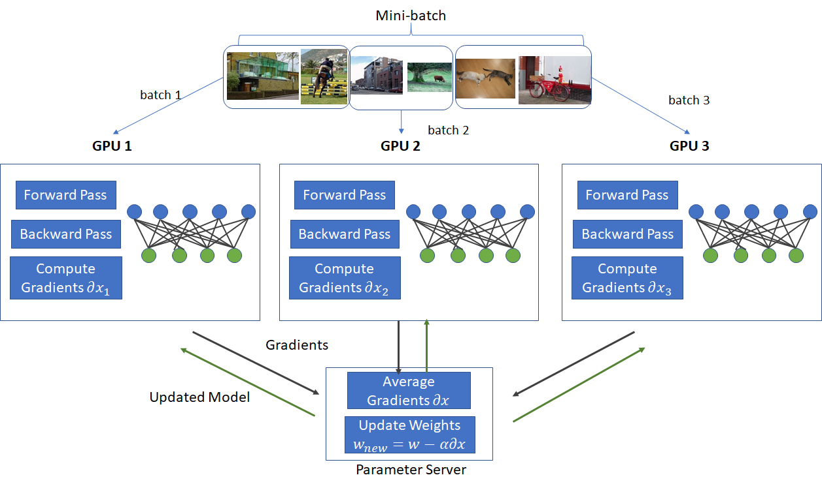
Parallelism in Deep Learning
Notes:
Valve is an entertainment and technology company that has developed a number
of popular games, as well as the Source engine, one of the most widely played game
engines available. Source is an animation engine used by Valve for its games and
licensed for other game developers.
In recent years, Valve has reprogrammed the Source engine software to use
multithreading to exploit the power of multicore processor chips from Intel and
AMD [REIM06]. The revised Source engine code provides more powerful support
for Valve games such as Half Life 2.
Figure 4.9 illustrates the thread structure for the rendering module. In this hierarchical
structure, higher-level threads spawn lower-level threads as needed. The
rendering module relies on a critical part of the Source engine, the world list, which is
a database representation of the visual elements in the game’s world. The first task is
to determine what are the areas of the world that need to be rendered. The next task
is to determine what objects are in the scene as viewed from multiple angles. Then
comes the processor-intensive work. The rendering module has to work out the rendering
of each object from multiple points of view, such as the player’s view, the view
of TV monitors, and the point of view of reflections in water.
Some of the key elements of the threading strategy for the rendering module
are listed in [LEON07] and include the following:
• Construct scene-rendering lists for multiple scenes in parallel (e.g., the world
and its reflection in water).
• Overlap graphics simulation.
• Compute character bone transformations for all characters in all scenes in
parallel.
• Allow multiple threads to draw in parallel.
The designers found that simply locking key databases, such as the world list,
for a thread was too inefficient. Over 95% of the time, a thread is trying to read
from a data set, and only 5% of the time at most is spent in writing to a data set.
Thus, a concurrency mechanism known as the single-writer-multiple-readers model
works effectively.

Slide 24
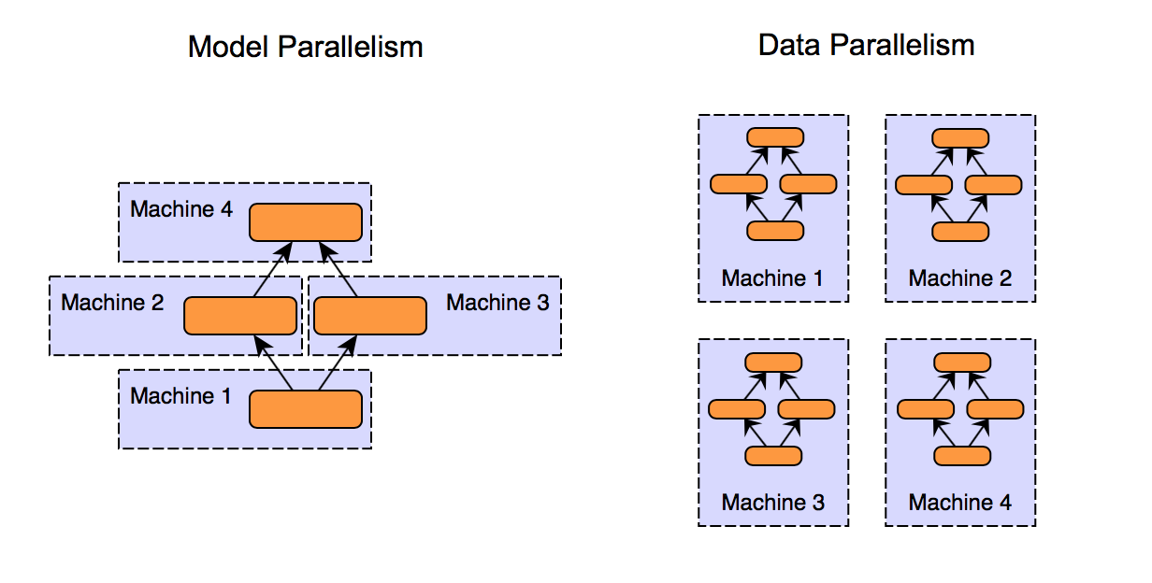
Parallelism in Deep Learning
Notes:
Valve is an entertainment and technology company that has developed a number
of popular games, as well as the Source engine, one of the most widely played game
engines available. Source is an animation engine used by Valve for its games and
licensed for other game developers.
In recent years, Valve has reprogrammed the Source engine software to use
multithreading to exploit the power of multicore processor chips from Intel and
AMD [REIM06]. The revised Source engine code provides more powerful support
for Valve games such as Half Life 2.
Figure 4.9 illustrates the thread structure for the rendering module. In this hierarchical
structure, higher-level threads spawn lower-level threads as needed. The
rendering module relies on a critical part of the Source engine, the world list, which is
a database representation of the visual elements in the game’s world. The first task is
to determine what are the areas of the world that need to be rendered. The next task
is to determine what objects are in the scene as viewed from multiple angles. Then
comes the processor-intensive work. The rendering module has to work out the rendering
of each object from multiple points of view, such as the player’s view, the view
of TV monitors, and the point of view of reflections in water.
Some of the key elements of the threading strategy for the rendering module
are listed in [LEON07] and include the following:
• Construct scene-rendering lists for multiple scenes in parallel (e.g., the world
and its reflection in water).
• Overlap graphics simulation.
• Compute character bone transformations for all characters in all scenes in
parallel.
• Allow multiple threads to draw in parallel.
The designers found that simply locking key databases, such as the world list,
for a thread was too inefficient. Over 95% of the time, a thread is trying to read
from a data set, and only 5% of the time at most is spent in writing to a data set.
Thus, a concurrency mechanism known as the single-writer-multiple-readers model
works effectively.

Slide 25
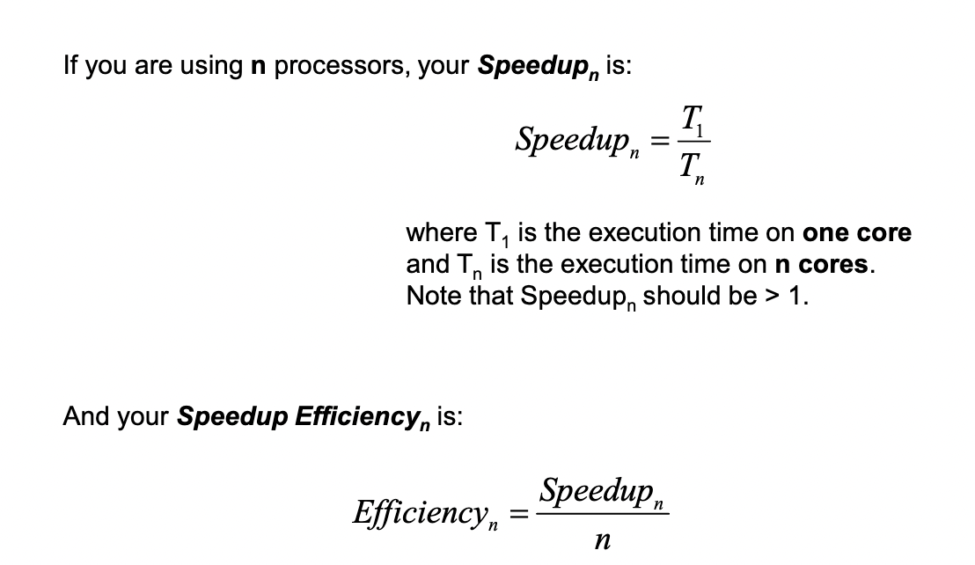
Amdahl’s Law

Slide 26
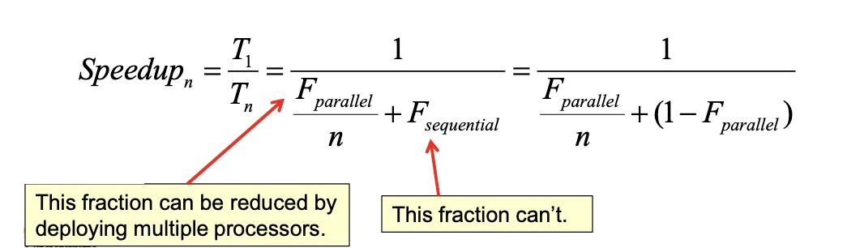
Amdahl’s Law
There are always some fraction of the total operation that is inherently sequential and cannot be parallelized no matter what you do. This includes reading data, setting up calculations, control logic, storing results, etc.
If you think of all the operations that a program needs to do as being divided between a fraction that is parallelizable and a fraction that isn’t (i.e., is stuck at being sequential), then Amdahl’s Law says:

Slide 27
Amdahl’s Law and Multithreading
Notes:
The potential performance benefits of a multicore organization depend on the ability to effectively exploit the parallel resources available to the application. Let us focus first on a single application running on a multicore system. Amdahl’s law (see Appendix E ) states that:
Speedup = time to execute program on a single processor time to execute program on N parallel processors
= 1 (1 - f ) + f N
The law assumes a program in which a fraction (1 - f) of the execution time involves code that is inherently serial and a fraction f that involves code that is infinitely parallelizable with no scheduling overhead. This law appears to make the prospect of a multicore organization attractive. But as Figure 4.7a shows, even a small amount of serial code has a noticeable impact. If only 10% of the code is inherently serial ( f = 0.9) , running the program on a multicore system with eight processors yields a performance gain of only a factor of 4.7. In addition, software typically incurs overhead as a result of communication and distribution of work to multiple processors and cache coherence overhead. This
results in a curve where performance peaks and then begins to degrade because of the increased burden of the overhead of using multiple processors. Figure 4.7b , from [MCDO07], is a representative example.

Slide 28
Is perfect scaling possible?
Notes:
However, software engineers have been addressing this problem and there are numerous applications in which it is possible to effectively exploit a multicore system. [MCDO07] reports on a set of database applications, in which great attention was paid to reducing the serial fraction within hardware architectures, operating systems, middleware, and the database application software. Figure 4.8 shows the result. As this example shows, database management systems and database applications are one area in which multicore systems can be used effectively. Many kinds of servers can also effectively use the parallel multicore organization, because servers typically handle numerous relatively independent transactions in parallel.

Slide 29
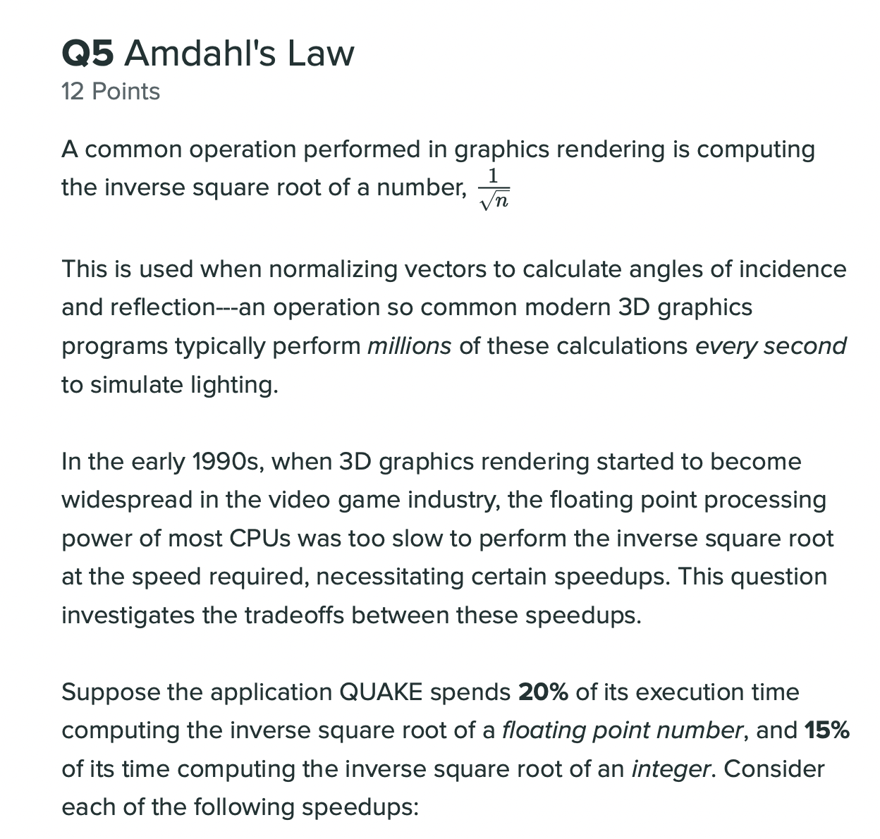
Amdahl’s Law Exam Question
Notes:
1. •p = 0.35
s = 1.2
speedup
2.
p = 0.2
s = 1.3
speedup
= 1 / [1-p + p/s] = 1/[1-0.2 + 0.2/1.30] = 1.048
= 1 / [1-p + p/s] = 1/[1-0.35 + 0.35/1.20] = 1.062
3. •p = 0.35 • s = 20 • speedup = 1 / [1-p + p/s] = 1/[1-0.35 + 0.35/20] = 1.498

Slide 30
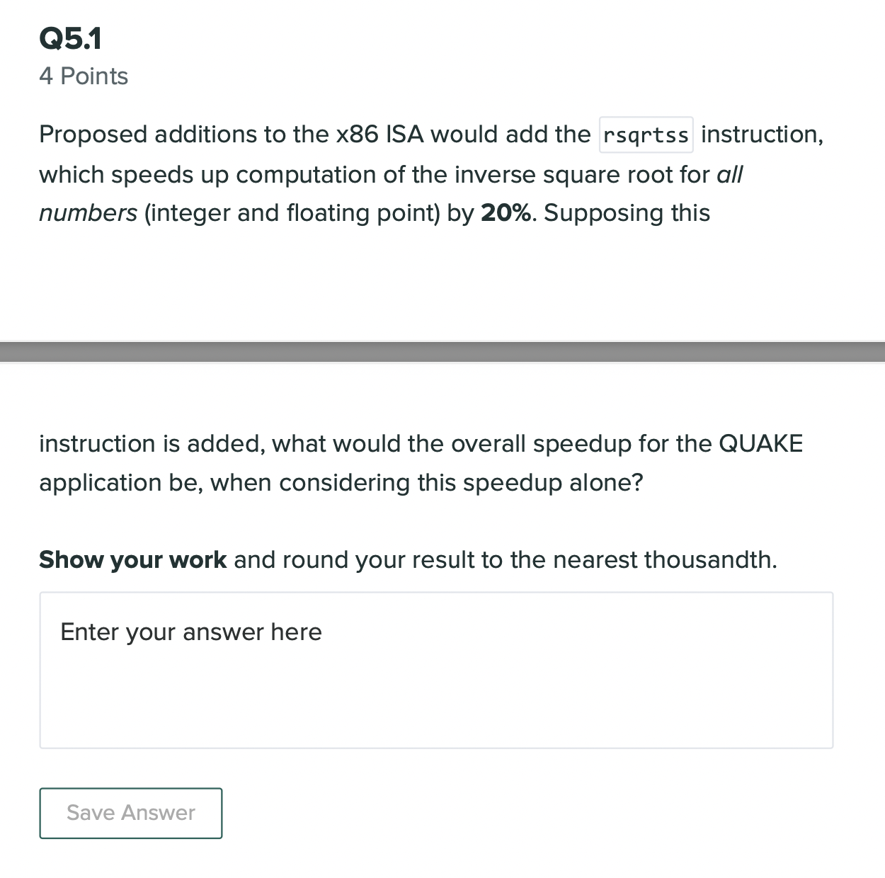
Amdahl’s Law Exam Question
Notes:
1. •p = 0.35
s = 1.2
speedup
2.
p = 0.2
s = 1.3
speedup
= 1 / [1-p + p/s] = 1/[1-0.2 + 0.2/1.30] = 1.048
= 1 / [1-p + p/s] = 1/[1-0.35 + 0.35/1.20] = 1.062
3. •p = 0.35 • s = 20 • speedup = 1 / [1-p + p/s] = 1/[1-0.35 + 0.35/20] = 1.498

Slide 31

Amdahl’s Law Exam Question
Notes:
1. •p = 0.35
s = 1.2
speedup
2.
p = 0.2
s = 1.3
speedup
= 1 / [1-p + p/s] = 1/[1-0.2 + 0.2/1.30] = 1.048
= 1 / [1-p + p/s] = 1/[1-0.35 + 0.35/1.20] = 1.062
3. •p = 0.35 • s = 20 • speedup = 1 / [1-p + p/s] = 1/[1-0.35 + 0.35/20] = 1.498

Slide 32
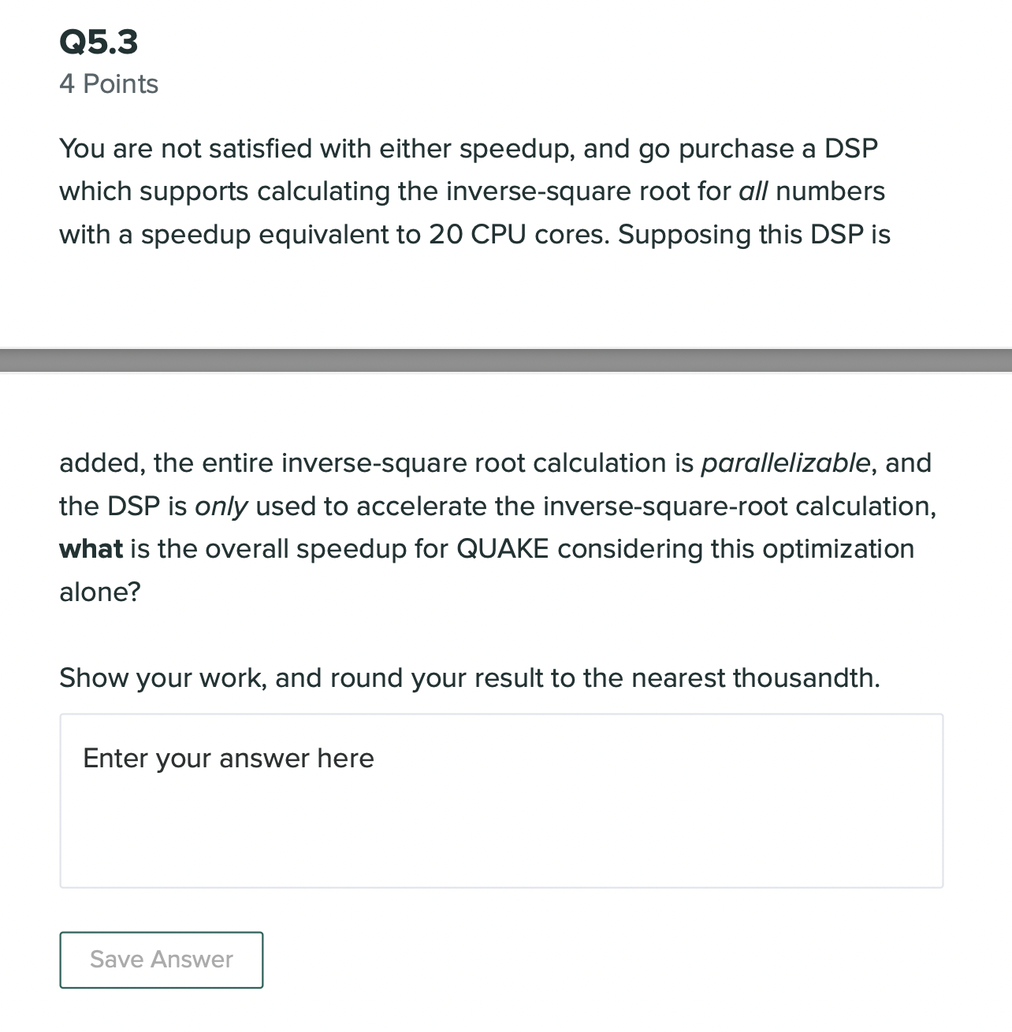
Amdahl’s Law Exam Question
Notes:
1. •p = 0.35
s = 1.2
speedup = 1 / [1-p + p/s] = 1/[1-0.35 + 0.35/1.20] = 1.062
2.
p = 0.2
s = 1.3
speedup
= 1 / [1-p + p/s] = 1/[1-0.2 + 0.2/1.30] = 1.048
3. •p = 0.35 • s = 20 • speedup = 1 / [1-p + p/s] = 1/[1-0.35 + 0.35/20] = 1.498

Slide 33
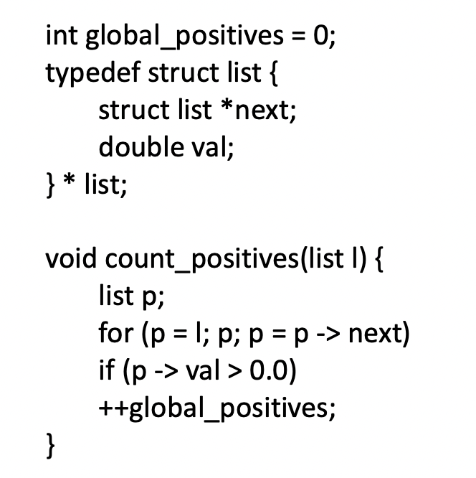
Problem Time
HW4. Q1. Many current language specifications, such as for C and C++, are inadequate for multithreaded programs. This can have an impact on compilers and the correctness of code, as this problem illustrates. Now consider the case in which thread A performs the function call: count_positives(<list with only neg.vals>); while thread B performs the function body and modifies: ++global_positives;
A) What does the function do? B) The C language only addresses single-threaded execution. Does the use of two parallel threads create any problems or potential problems?
B
A
Notes:
Counts the number of positive elements in the provided list.
This should work correctly since in this particular case, thread A, due to being provided a list of only negative values, will never actually be updating the “global_positive” variable, and as such the two threads operate on distinct global data and do not require any locking.

Slide 34
Problem Time
HW4. Q2. Some existing optimizing compilers (including gcc, which tends to be relatively conservative) will "optimize" count positives to something similar to:
What problem or potential problems occur with this compiled version of the program if threads A and B are executed concurrently?
B
void count_positives(list l) {
list p; register int r; r = global_positives; for (p = l; p; p = p -> next) if (p -> val > 0.0) ++r; global_positives = r;
}
A
Notes:
Because global_positives will now “always” be accessed regardless of the contents of the provided list, the same scenario from the previous problem is now problematic since there is now a race condition and possible loss of data, since global_positives can be overwritten.

Slide 35
Chapter 4
Processes and threads
Multithreading
Thread functionality
Multicore and multithreading
Types of threads
User level and kernel level threads
Solaris thread and SMP management
Multithreaded architecture
Motivation
Process structure
Thread execution
Interrupts as threads
Linux process and thread management
Tasks/threads/namespaces
Mac OS X grand central dispatch
Notes:
Chapter 4 summary.

Slide 36
User Level Thread (ULT)
Kernel level Thread (KLT)
Notes:
There are two broad categories of thread implementation: user-level threads (ULTs) and kernel-level threads (KLTs). The latter are also referred to in the literature as kernel-supported threads or lightweight processes.

Slide 37
User-Level Threads (ULTs)
All thread management is done by the application
The kernel is not aware of the existence of threads
Notes:
In a pure ULT facility, all of the work of thread management is done by the application and the kernel is not aware of the existence of threads. Figure 4.5a illustrates the pure ULT approach. Any application can be programmed to be multithreaded by using a threads library, which is a package of routines for ULT management. The threads library contains code for creating and destroying threads, for passing messages and data between threads, for scheduling thread execution, and for saving and restoring thread contexts.
By default, an application begins with a single thread and begins running in that thread. This application and its thread are allocated to a single process managed by the kernel. At any time that the application is running (the process is in the Running state), the application may spawn a new thread to run within the same process. Spawning is done by invoking the spawn utility in the threads library. Control is passed to that utility by a procedure call. The threads library creates a data structure for the new thread and then passes control to one of the threads within this process that is in the Ready state, using some scheduling algorithm. When control is passed to the library, the context of the current thread is saved, and when control is passed from the library to a thread, the context of that thread is restored. The context essentially consists of the contents of user registers, the program counter, and stack pointers.

Slide 38
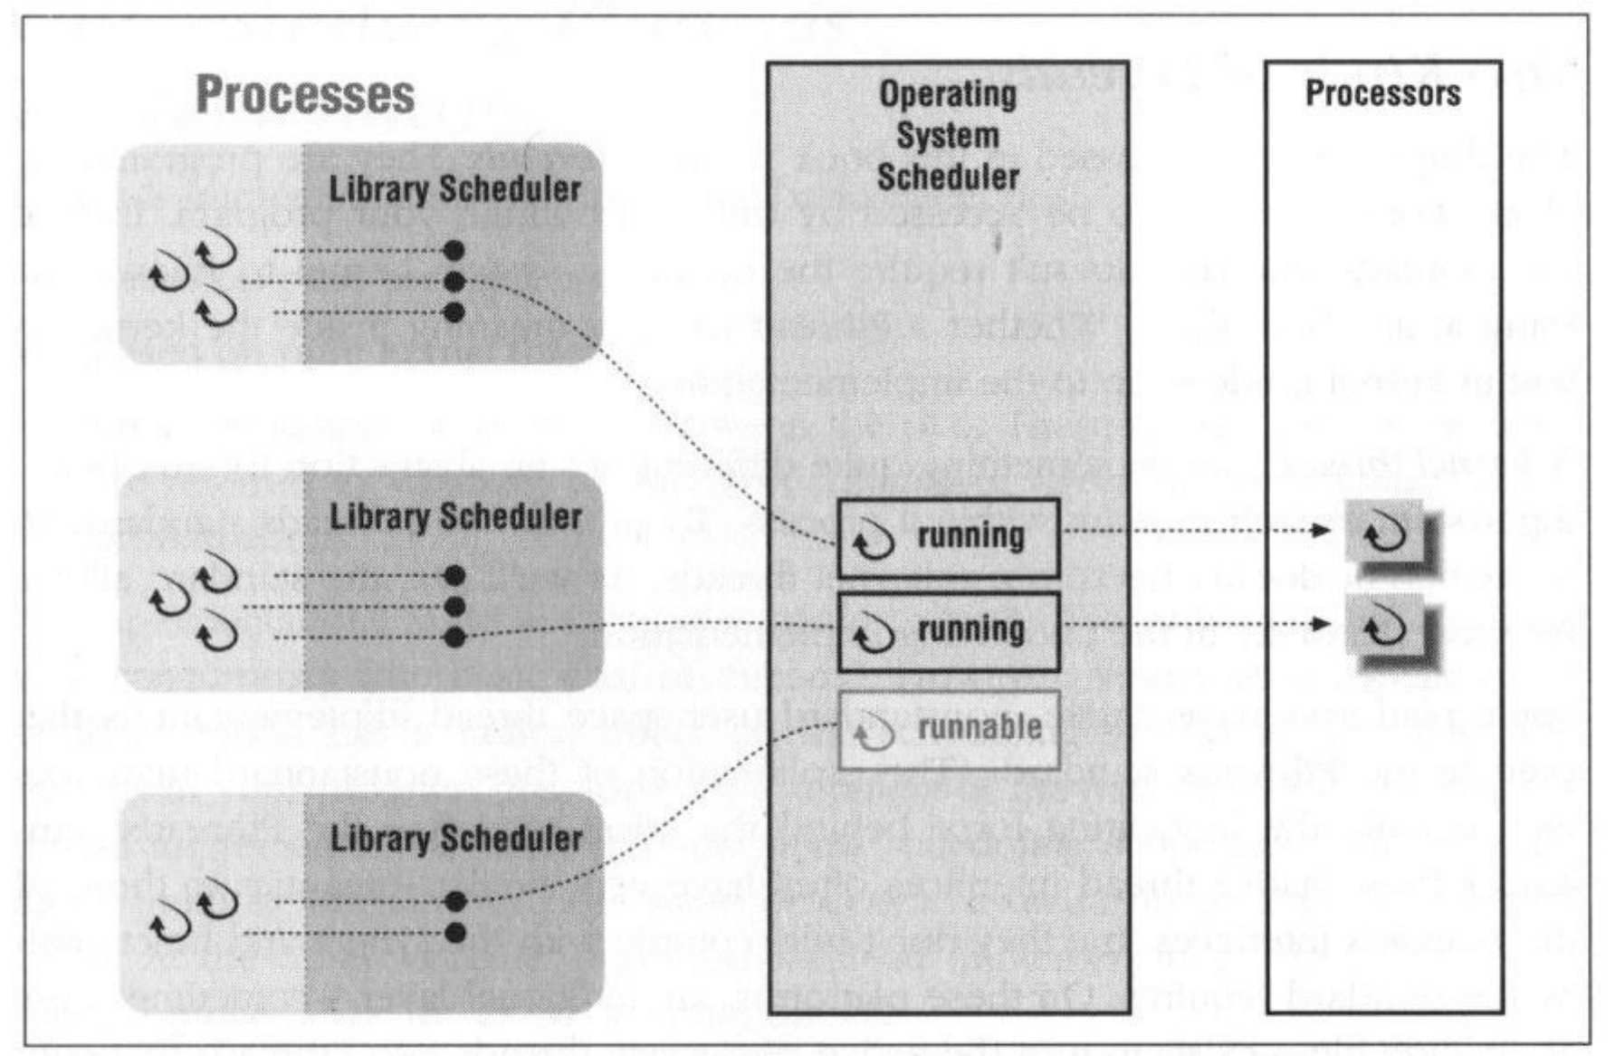
User-Level Threads
The OS only schedules the process, not the threads.

Slide 39
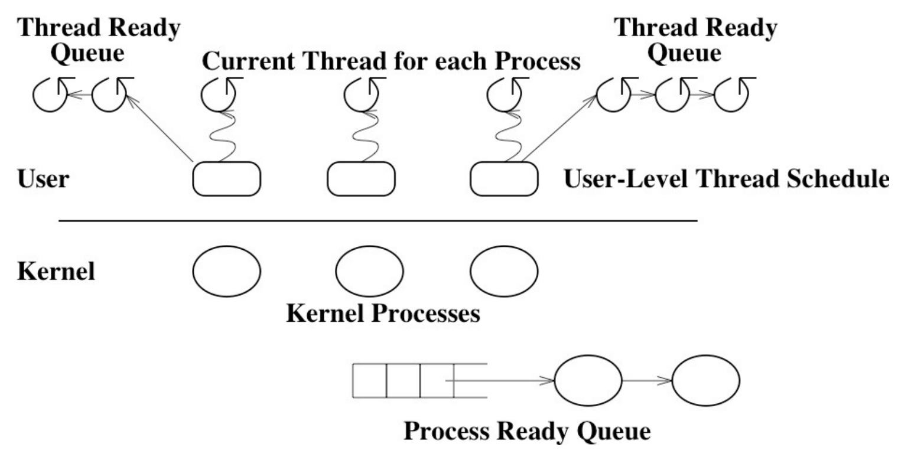
User-Level Threads

Slide 40
Notes:
All of the activity described in the preceding paragraph takes place in user space and within a single process. The kernel is unaware of this activity. The kernel continues to schedule the process as a unit and assigns a single execution state (Ready, Running, Blocked, etc.) to that process. The following examples should clarify the relationship between thread scheduling and process scheduling. Suppose that process B is executing in its thread 2; the states of the process and two ULTs that are part of the process are shown in Figure 4.6a . Each of the following is a possible occurrence:
1. The application executing in thread 2 makes a system call that blocks B. For
example, an I/O call is made. This causes control to transfer to the kernel. The kernel invokes the I/O action, places process B in the Blocked state, and switches to another process. Meanwhile, according to the data structure maintained by the threads library, thread 2 of process B is still in the Running state. It is important to note that thread 2 is not actually running in the sense of being executed on a processor; but it is perceived as being in the Running state by the threads library. The corresponding state diagrams are shown in Figure 4.6b .
2. A clock interrupt passes control to the kernel and the kernel determines
that the currently running process (B) has exhausted its time slice. The kernel places process B in the Ready state and switches to another process. Meanwhile, according to the data structure maintained by the threads library, thread 2 of process B is still in the Running state. The corresponding state diagrams are shown in Figure 4.6c .
3. Thread 2 has reached a point where it needs some action performed by thread
1 of process B. Thread 2 enters a Blocked state and thread 1 transitions from Ready to Running. The process itself remains in the Running state. The corresponding state diagrams are shown in Figure 4.6d .
In cases 1 and 2 ( Figures 4.6b and 4.6c ), when the kernel switches control back to process B, execution resumes in thread 2. Also note that a process can be interrupted, either by exhausting its time slice or by being preempted by a higher priority process, while it is executing code in the threads library. Thus, a process may be in the midst of a thread switch from one thread to another when interrupted. When that process is resumed, execution continues within the threads library, which completes the thread switch and transfers control to another thread within that process.

Slide 41
Advantages of ULTs
Thread switching does not require kernel mode privileges
Scheduling can be application specific
ULTs can run on any OS
Notes:
There are a number of advantages to the use of ULTs instead of KLTs, including the following:
1. Thread switching does not require kernel mode privileges because all of the
thread management data structures are within the user address space of a single process. Therefore, the process does not switch to the kernel mode to do thread management. This saves the overhead of two mode switches (user to kernel; kernel back to user).
2. Scheduling can be application specific. One application may benefit most
from a simple round-robin scheduling algorithm, while another might benefit from a priority-based scheduling algorithm. The scheduling algorithm can be tailored to the application without disturbing the underlying OS scheduler.
3. ULTs can run on any OS. No changes are required to the underlying kernel
to support ULTs. The threads library is a set of application-level functions shared by all applications.

Slide 42
Disadvantages of ULTs
In a typical OS many system calls are blocking
as a result, when a ULT executes a system call, not only is that thread blocked, but all of the threads within the process are blocked
In a pure ULT strategy, a multithreaded application cannot take advantage of multiprocessing
Notes:
There are two distinct disadvantages of ULTs compared to KLTs:
1. In a typical OS, many system calls are blocking. As a result, when a ULT
executes a system call, not only is that thread blocked, but also all of the threads within the process are blocked.
2. In a pure ULT strategy, a multithreaded application cannot take advantage
of multiprocessing. A kernel assigns one process to only one processor at a time. Therefore, only a single thread within a process can execute at a time. In effect, we have application-level multiprogramming within a single process. While this multiprogramming can result in a significant speedup of the application, there are applications that would benefit from the ability to execute portions of code simultaneously.

Slide 43

Sample Exam Question
With a multi-threaded process, a context switch between threads is performed by the OS kernel.
Only with user-level threads.
Only with kernel-level threads.
Always.
Never.

Slide 44
Sample Exam Question
With a multi-threaded process, a context switch between threads is performed by the OS kernel.
Only with user-level threads.
Only with kernel-level threads.
Always.
Never.

Slide 45
Overcoming ULT Disadvantages
Jacketing
converts a blocking system call into a non-blocking system call
Writing an application as multiple processes rather than multiple threads
Notes:
There are ways to work around these two problems. For example, both problems can be overcome by writing an application as multiple processes rather than multiple threads. But this approach eliminates the main advantage of threads: Each switch becomes a process switch rather than a thread switch, resulting in much greater overhead. Another way to overcome the problem of blocking threads is to use a technique referred to as jacketing . The purpose of jacketing is to convert a blocking system call into a non-blocking system call. For example, instead of directly calling a system I/O routine, a thread calls an application-level I/O jacket routine. Within this jacket routine is code that checks to determine if the I/O device is busy. If it is, the thread enters the Blocked state and passes control (through the threads library) to another thread. When this thread later is given control again, the jacket routine checks the I/O device again.

Slide 46
Kernel-Level Threads (KLTs)
Thread management is done by the kernel
no thread management is done by the application
Windows is an example of this approach
Notes:
In a pure KLT facility, all of the work of thread management is done by the kernel. There is no thread management code in the application level, simply an application programming interface (API) to the kernel thread facility. Windows is an example of this approach. Figure 4.5b depicts the pure KLT approach. The kernel maintains context information for the process as a whole and for individual threads within the process.

Slide 47
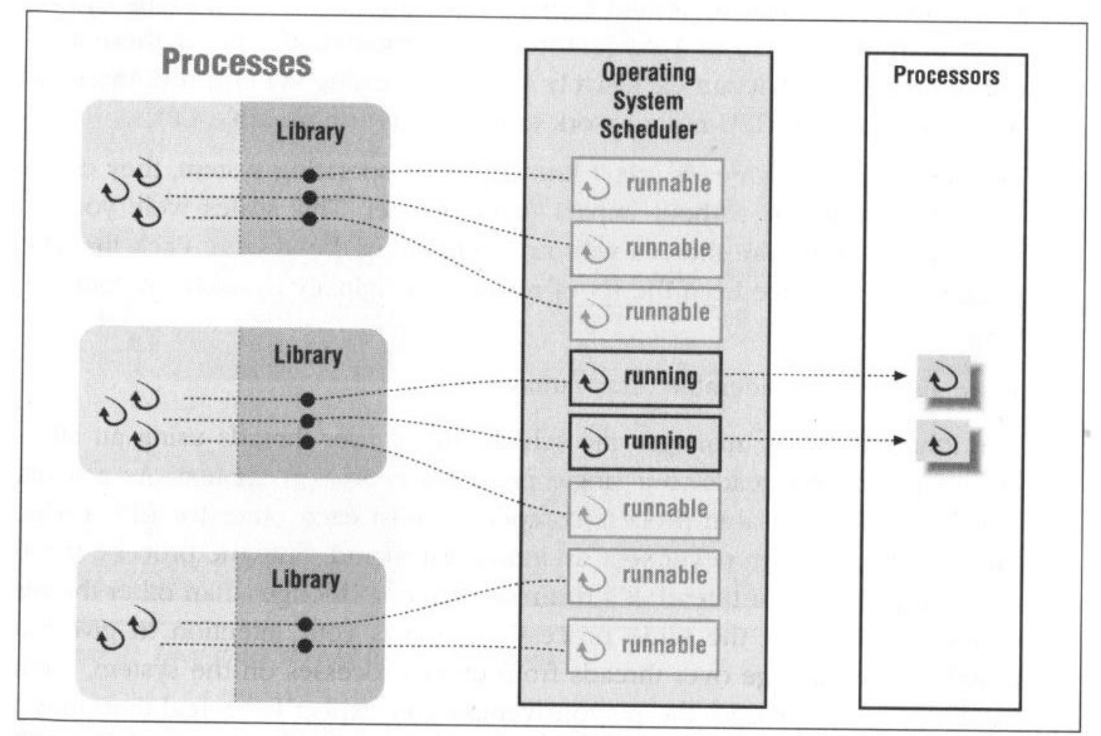
Kernel Threads
The kernel must manage and schedule threads (as well as processes), but it can use the same CPU process scheduling algorithms.
Switching between kernel threads is slightly faster than switching between processes.

Slide 48
Advantages of KLTs
The kernel can simultaneously schedule multiple threads from the same process on multiple processors
If one thread in a process is blocked, the kernel can schedule another thread of the same process
Kernel routines can be multithreaded
Notes:
Scheduling by the kernel is done on a thread basis. This approach overcomes the two principal drawbacks of the ULT approach. First, the kernel can simultaneously schedule multiple threads from the same process on multiple processors. Second, if one thread in a process is blocked, the kernel can schedule another thread of the same process. Another advantage of the KLT approach is that kernel routines themselves can be multithreaded.

Slide 49
Disadvantage of KLTs
The transfer of control from one KLT thread to another within the same process requires a mode switch to the kernel
Table 4.1
Thread and Process Operation Latencies (μs)
Notes:
The principal disadvantage of the KLT approach compared to the ULT approach is that the transfer of control from one thread to another within the same process requires a mode switch to the kernel. To illustrate the differences, Table 4.1 shows the results of measurements taken on a uniprocessor VAX computer running a UNIX-like OS. The two benchmarks are as follows: Null Fork, the time to create, schedule, execute, and complete a process/thread that invokes the null procedure (i.e., the overhead of forking a process/thread); and Signal-Wait, the time for a process/thread to signal a waiting process/thread and then wait on a condition (i.e., the overhead of synchronizing two processes/threads together). We see that there is
an order of magnitude or more of difference between ULTs and KLTs and similarly between KLTs and processes.

Slide 50
Sample Exam Question
About the kernel thread, which one is correct?
A kernel thread is a thread that the operating system knows about.
The kernel must manage and schedule threads, but it can use the same CPU process scheduling algorithms.
Switching between kernel threads is slightly faster than switching between processes.
All of the mentioned.

Slide 51
Sample Exam Question
About the kernel thread, which one is correct?
A kernel thread is a thread that the operating system knows about.
The kernel must manage and schedule threads, but it can use the same CPU process scheduling algorithms.
Switching between kernel threads is slightly faster than switching between processes.
All of the mentioned.

Slide 52
Problem Time
HW4.Q3 In the discussion of ULTs versus KLTs, it was pointed out that a disadvantage of ULTs is that when a ULT executes a system call, not only is that thread blocked, but also all of the threads within the process are blocked. Why is that so?
HW4.Q4 Consider an environment in which there is a one-to-one mapping between user-level threads and kernel-level threads within a process to issue blocking system calls while other threads continue to run. Explain why this model can make multi-threaded programs run faster than their single-threaded counterparts on a uniprocess computer.
Notes:
Because the thread structure of a process is not visible to the operating system and ULTs are a process side concept. As such, when one of the threads blocks and inevitably requests a system resource, the operating system simply sees the process as a whole being blocked on this request
Foreground/background work; asynchronous processing; speedup of execution by parallel processing of data; modular program structure.

Slide 53
Combined Approaches
Thread creation is done in the user space
Bulk of scheduling and synchronization of threads is by the application
(Historical) Solaris is an example
Notes:
Some operating systems provide a combined ULT/ KLT facility ( Figure 4.5c ). In a combined system, thread creation is done completely in user space, as is the bulk of the scheduling and synchronization of threads within an application. The multiple ULTs from a single application are mapped onto some (smaller or equal) number of KLTs. The programmer may adjust the number of KLTs for a particular application and processor to achieve the best overall results. In a combined approach, multiple threads within the same application can run in parallel on multiple processors, and a blocking system call need not block the entire process. If properly designed, this approach should combine the advantages of the pure ULT and KLT approaches while minimizing the disadvantages. Solaris is a good example of an OS using this combined approach. The current Solaris version limits the ULT/KLT relationship to be one-to-one.

Slide 54
Multithreading Models
Many-to-One
One-to-One
Many-to-Many

Slide 55
Many-to-One
Many user-level threads mapped to single kernel thread
One thread blocking causes all to block
Disadvantage:
Multiple threads may not run in parallel on muticore system because only one may be in kernel at a time
Few systems currently use this model
Examples:
Solaris Green Threads
GNU Portable Threads
It does not result in true concurrency, because the kernel can schedule only one thread at a time
Notes:
Thread management is done by the thread library in user space, so it is efficient

Slide 56
One-to-One
Each user-level thread maps to kernel thread
Creating a user-level thread creates a kernel thread
More concurrency than many-to-one
Number of threads per process sometimes restricted due to overhead
Examples
Windows
Linux
Solaris 9 and later
The one-to-one model allows greater concurrency, but the developer has to be careful not to create too many threads within an application
Notes:
The only drawback to this model is that creating a user thread requires creating the corresponding kernel thread. Because the overhead of creating kernel threads can burden the performance of an application, most implementations of this model restrict the number of threads supported by the system.

Slide 57
Many-to-Many Model
Allows many user level threads to be mapped to many kernel threads
Allows the operating system to create a sufficient number of kernel threads
Solaris prior to version 9
Windows with the ThreadFiber package
Developers can create as many user threads as necessary
The corresponding kernel threads can run in parallel on a multiprocessor
When a thread performs a blocking system call, the kernel can schedule another thread for execution.

Slide 58
Two-level Model
Similar to M:M, except that it allows a user thread to be bound to kernel thread
Examples
IRIX
HP-UX
Tru64 UNIX
Solaris 8 and earlier

Slide 59
Chapter 4
Processes and threads
Multithreading
Thread functionality
Multicore and multithreading
Types of threads
User level and kernel level threads
Solaris thread and SMP management
Multithreaded architecture
Motivation
Process structure
Thread execution
Interrupts as threads
Linux process and thread management
Tasks/threads/namespaces
Mac OS X grand central dispatch
Notes:
Chapter 4 summary.

Slide 60
Solaris Process
Solaris makes use of four thread-related concepts:
Process
includes the user’s address space, stack, and process control block
User-level Threads
a user-created unit of execution within a process
Lightweight Processes (LWP)
a mapping between ULTs and kernel threads
Kernel Threads
fundamental entities that can be scheduled and dispatched to run on one of the system processors
Notes:
Solaris makes use of four separate thread-related concepts:
• Process: This is the normal UNIX process and includes the user’s address
space, stack, and process control block.
• User-level threads: Implemented through a threads library in the address
space of a process, these are invisible to the OS. A user-level thread (ULT) is a user-created unit of execution within a process.
• Lightweight processes: A lightweight process (LWP) can be viewed as a mapping
between ULTs and kernel threads. Each LWP supports ULT and maps to one kernel thread. LWPs are scheduled by the kernel independently and may execute in parallel on multiprocessors.
• Kernel threads: These are the fundamental entities that can be scheduled and
dispatched to run on one of the system processors.

Slide 61
Notes:
Figure 4.12 illustrates the relationship among these four entities. Note that there is always exactly one kernel thread for each LWP. An LWP is visible within a process to the application. Thus, LWP data structures exist within their respective process address space. At the same time, each LWP is bound to a single dispatchable kernel thread, and the data structure for that kernel thread is maintained within the kernel’s address space.
A process may consist of a single ULT bound to a single LWP. In this case, there is a single thread of execution, corresponding to a traditional UNIX process. When concurrency is not required within a single process, an application uses this process structure. If an application requires concurrency, its process contains multiple threads, each bound to a single LWP, which in turn are each bound to a single kernel thread.
In addition, there are kernel threads that are not associated with LWPs. The kernel creates, runs, and destroys these kernel threads to execute specific system functions. The use of kernel threads rather than kernel processes to implement system functions reduces the overhead of switching within the kernel (from a process switch to a thread switch).

Slide 62
A Lightweight Process (LWP) Data Structure Includes:
An LWP identifier
The priority of this LWP
A signal mask
Saved values of user-level registers
The kernel stack for this LWP
Resource usage and profiling data
Pointer to the corresponding kernel thread
Pointer to the process structure
Notes:
Figure 4.13 compares, in general terms, the process structure of a traditional UNIX system with that of Solaris. On a typical UNIX implementation, the process structure includes the process ID; the user IDs; a signal dispatch table, which the kernel uses to decide what to do when sending a signal to a process; file descriptors, which describe the state of files in use by this process; a memory map, which defines the address space for this process; and a processor state structure, which includes the kernel stack for this process. Solaris retains this basic structure but replaces the processor state block with a list of structures containing one data block for each LWP.
The LWP data structure includes the following elements:
• An LWP identifier
• The priority of this LWP and hence the kernel thread that supports it
• A signal mask that tells the kernel which signals will be accepted
• Saved values of user-level registers (when the LWP is not running)
• The kernel stack for this LWP, which includes
system call arguments,
- results, and
- error codes for each call level
• Resource usage and profiling data
• Pointer to the corresponding kernel thread
• Pointer to the process structure

Slide 63
Notes:
Figure 4.14 shows a simplified view of both thread execution states. These states reflect the execution status of both a kernel thread and the LWP bound to it. As mentioned, some kernel threads are not associated with an LWP; the same execution diagram applies. The states are as follows:
• RUN: The thread is runnable; that is, the thread is ready to execute.
• ONPROC: The thread is executing on a processor.
• SLEEP: The thread is blocked.
• STOP: The thread is stopped.
• ZOMBIE: The thread has terminated.
• FREE: Thread resources have been released and the thread is awaiting removal from the OS thread data structure.
A thread moves from ONPROC to RUN if it is preempted by a higher-priority thread or because of time slicing. A thread moves from ONPROC to SLEEP if it is blocked and must await an event to return the RUN state. Blocking occurs if the thread invokes a system call and must wait for the system service to be performed. A thread enters the STOP state if its process is stopped; this might be done for debugging purposes.
The IDL state is actually a process state, and PINNED is not technically a thread state but is shown because it represents a potentially common transition that kernel threads make during execution. Processor needs an interrupt and pin pending thread and then switch back.

Slide 64
Interrupts as Threads
Most operating systems contain two fundamental forms of concurrent activity:
Interrupts
synchronized by preventing their handling for a period of time
cooperate with each other and manage the use of shared data structures by primitives that enforce mutual exclusion and synchronize their execution
Processes (threads)
Notes:
Most operating systems contain two fundamental forms of concurrent activity: processes and interrupts. Processes (or threads) cooperate with each other and manage the use of shared data structures by means of a variety of primitives that enforce mutual exclusion (only one process at a time can execute certain code or access certain data) and that synchronize their execution. Interrupts are synchronized by preventing their handling for a period of time. Solaris unifies these two concepts into a single model, namely kernel threads and the mechanisms
for scheduling and executing kernel threads. To do this, interrupts are converted to kernel threads.
The motivation for converting interrupts to threads is to reduce overhead. Interrupt handlers often manipulate data shared by the rest of the kernel. Therefore, while a kernel routine that accesses such data is executing, interrupts must be blocked, even though most interrupts will not affect that data. Typically, the way this is done is for the routine to set the interrupt priority level higher to block interrupts and then lower the priority level after access is completed. These operations take time. The problem is magnified on a multiprocessor system. The kernel must protect more objects and may need to block interrupts on all processors.

Slide 65
Solaris Solution
Solaris employs a set of kernel threads to handle interrupts
an interrupt thread has its own identifier, priority, context, and stack
the kernel controls access to data structures and synchronizes among interrupt threads using mutual exclusion primitives
interrupt threads are assigned higher priorities than all other types of kernel threads
Notes:
When an interrupt occurs, it is delivered to a particular processor and the thread that was executing on that processor is pinned. A pinned thread cannot move to another processor and its context is preserved; it is simply suspended until the interrupt is processed. The processor then begins executing an interrupt thread. There is a pool of deactivated interrupt threads available, so that a new thread creation is not required. The interrupt thread then executes to handle the interrupt. If the handler routine needs access to a data structure that is currently locked in some fashion for use by another executing thread, the interrupt thread must wait for access to that data structure. An interrupt thread can only be preempted by another
interrupt thread of higher priority.
Experience with Solaris interrupt threads indicates that this approach provides superior performance to the traditional interrupt-handling strategy [KLEI95].

Slide 66
Chapter 4
Processes and threads
Multithreading
Thread functionality
Multicore and multithreading
Types of threads
User level and kernel level threads
Solaris thread and SMP management
Multithreaded architecture
Motivation
Process structure
Thread execution
Interrupts as threads
Linux process and thread management
Tasks/threads/namespaces
Mac OS X grand central dispatch
Notes:
Chapter 4 summary.

Slide 67
How does modern Linux handle threads?
The Linux scheduler is scheduling schedulable tasks or simply tasks.
A task may be :
a single-threaded process (e.g. created by fork without any thread library)
any thread inside a multi-threaded process (including its main thread), in particular Posix threads (pthreads)
kernel tasks, which are started internally in the kernel and stay in kernel land (e.g. kworker, nfsiod, kjournald , kauditd, kswapd etc etc...)
In other words, threads inside multi-threaded processes are scheduled like non-threaded -i.e. single threaded- processes.
The low-level clone(2) syscall creates user-land schedulable tasks (and can be used both for creating fork-ed process or for implementation of thread libraries, like pthread). Unless you are a low-level thread library implementor, you don't want to use clone directly.

Slide 68
Linux Tasks
A process, or task, in Linux is represented by a task_struct data structure. The task_struct data structure contains information in a number of categories:
• State: The execution state of the process (executing, ready, suspended, stopped, zombie). This is described subsequently.
• Scheduling information: Information needed by Linux to schedule processes. A process can be normal or real time and has a priority. Real-time processes are scheduled before normal processes, and within each category, relative priorities can be used. A counter keeps track of the amount of time a process is allowed to execute.
• Identifiers: Each process has a unique process identifier and also has user and group identifiers. A group identifier is used to assign resource access privileges to a group of processes.
• Interprocess communication: Linux supports the IPC mechanisms found in UNIX SVR4, described in Chapter 6 .
• Links: Each process includes a link to its parent process, links to its siblings (processes with the same parent), and links to all of its children.
• Times and timers: Includes process creation time and the amount of processor time so far consumed by the process. A process may also have associated one or more interval timers. A process defines an interval timer by means of a system call; as a result, a signal is sent to the process when the timer expires. A timer may be single use or periodic.
• File system: Includes pointers to any files opened by this process, as well as pointers to the current and the root directories for this process.
• Address space: Defines the virtual address space assigned to this process.
• Processor-specific context: The registers and stack information that constitute the context of this process.
Notes:
A process, or task, in Linux is represented by a task_struct data structure. The task_struct data structure contains information in a number of categories:
• State:
The execution state of the process (executing, ready, suspended, stopped, zombie). This is described subsequently.
• Scheduling information:
Information needed by Linux to schedule processes. A process can be normal or real time and has a priority. Real-time processes are scheduled before normal processes, and within each category, relative priorities can be used. A counter keeps track of the amount of time a process is allowed to execute.
• Identifiers:
Each process has a unique process identifier and also has user and group identifiers. A group identifier is used to assign resource access privileges to a group of processes.
• Interprocess communication:
Linux supports the IPC mechanisms found in UNIX SVR4, described in Chapter 6 .
• Links:
Each process includes a link to its parent process, links to its siblings (processes with the same parent), and links to all of its children.
Times and timers:
Includes process creation time and the amount of processor time so far consumed by the process. A process may also have associated one or more interval timers. A process defines an interval timer by means of a system call; as a result, a signal is sent to the process when the timer expires. A timer may be single use or periodic.
• File system:
Includes pointers to any files opened by this process, as well as pointers to the current and the root directories for this process.
• Address space:
Defines the virtual address space assigned to this process.
• Processor-specific context:
The registers and stack information that constitute the context of this process.

Slide 69
Interruptable: (e.g. read() )
While the process is sleeping in the system call, it can receive a unix asynchronous signal (say, SIGTERM), then the following happens:
The system calls exits prematurely, and is set up to return -EINTR to userspace.
The signal handler is executed.
If the process is still running, it gets the return value from the system call, and it can make the same call again.
Uninterruptable: (e.g. mkdir() )
If the system calls stalls for some reason, the process can indefinitely remains in this unkillable state.
Notes:
Figure 4.15 shows the execution states of a process. These are as follows:
Running:
Corresponds to two states.
A Running process is either executing or
it is ready to execute.
Interruptible:
A blocked state, in which the process is waiting for an event, such as the end of an I/O operation, the availability of a resource, or a signal from another process.
Uninterruptible:
Another blocked state.
The difference between the Interruptible state is that in this state, a process is waiting directly on hardware conditions and therefore will not handle any signals.
Stopped:
The process has been halted and can only resume by positive action from another process.
E.G., a process that is being debugged can be put into the Stopped state.
Zombie:
The process has been terminated but, for some reason, still must have its task structure in the process table.

Slide 70
Linux Threads
Linux does not recognize a distinction between threads and processes
User-level threads are mapped into kernel-level processes
A new process is created by copying the attributes of the current process
The new process can be cloned so that it shares resources
The clone() call creates separate stack spaces for each process
Notes:
Traditional UNIX systems support a single thread of execution per process, while modern UNIX systems typically provide support for multiple kernel-level threads per process. As with traditional UNIX systems, older versions of the Linux kernel offered no support for multithreading. Instead, applications would need to be written with a set of user-level library functions, the most popular of which is known as pthread (POSIX thread) libraries , with all of the threads mapping into a single kernel-level process. We have seen that modern versions of UNIX offer kernel-level threads. Linux provides a unique solution in that it does not recognize a distinction between threads and processes. Using a mechanism similar to the lightweight processes of Solaris, user-level threads are mapped into kernel-level processes. Multiple user-level threads that constitute a single user-level process are mapped into Linux kernel-level processes that share the same group ID. This enables these processes to share resources such as files and memory and to avoid the need for a context switch when the scheduler switches among processes in the same group.
A new process is created in Linux by copying the attributes of the current process. A new process can be cloned so that it shares resources, such as files, signal handlers, and virtual memory. When the two processes share the same virtual memory, they function as threads within a single process. However, no separate type of data structure is defined for a thread. In place of the usual fork() command, processes are created in Linux using the clone() command. This command includes a set of flags as arguments, defined in Table 4.5 . The traditional fork() system call is implemented by Linux as a clone() system call with all of the clone flags cleared.
When the Linux kernel performs a switch from one process to another, it checks whether the address of the page directory of the current process is the same as that of the to-be-scheduled process. If they are, then they are sharing the same address space, so that a context switch is basically just a jump from one location of code to another location of code.
Although cloned processes that are part of the same process group can share the same memory space, they cannot share the same user stacks. Thus the clone() call creates separate stack spaces for each process.

Slide 71
Linux Namespaces
A namespace enables a process to have a different view of the system than other processes that have other associated namespaces
One of the overall goals is to support the implementation of control groups, cgroups), a tool for lightweight virtualization that provides a process or group of processes with the illusion that they are the only processes on the system
There are currently six namespaces in Linux
mnt
pid
net
ipc
uts
user
Notes:
Associated with each process in Linux are a set of namespaces . A namespace enables
a process (or multiple processes that share the same namespace) to have a different
view of the system than other processes that have other associated namespaces.
One of the overall goals of namespaces is to support the implementation of control
groups (cgroups, formerly called containers), a tool for lightweight virtualization
(as well as other purposes) that provides a process or group of processes with the
illusion that they are the only processes on the system. Thus, the cgroup is a form
of virtual machine. There are currently six namespaces in Linux: mnt, pid, net, ipc,
uts, and user.
Namespaces are created by the clone() system call, which gets as a parameter
one of the six namespaces clone flags (CLONE_NEWNS, CLONE_NEWPID,
CLONE_NEWNET, CLONE_NEWIPC, CLONE_NEWUTS, and CLONE_
NEWUSER). A process can also create a namespace with the unshare() system call
with one of these flags; as opposed to clone(), a process is not created in such a case;
only a new namespace is created, which is attached to the calling process.

Slide 72
Chapter 4
Processes and threads
Multithreading
Thread functionality
Multicore and multithreading
Types of threads
User level and kernel level threads
Solaris thread and SMP management
Multithreaded architecture
Motivation
Process structure
Thread execution
Interrupts as threads
Linux process and thread management
Tasks/threads/namespaces
Mac OS X grand central dispatch
Notes:
Chapter 4 summary.

Slide 73
Mac OS X Grand Central Dispatch (GCD)
Provides a pool of available threads
Designers can designate portions of applications, called blocks, that can be dispatched independently and run concurrently
Concurrency is based on the number of cores available and the thread capacity of the system
Notes:
As was mentioned in Chapter 2 , Mac OS X Grand Central Dispatch (GCD) provides a pool of available threads. Designers can designate portions of applications, called blocks, that can be dispatched independently and run concurrently. The OS will provide as much concurrency as possible based on the number of cores available and the thread capacity of the system. Although other operating systems have implemented thread pools, GCD provides a qualitative improvement in ease of use and efficiency.

Slide 74
Chapter 4 -- END
Processes and threads
Multithreading
Thread functionality
Multicore and multithreading
Types of threads
User level and kernel level threads
Solaris thread and SMP management
Multithreaded architecture
Motivation
Process structure
Thread execution
Interrupts as threads
Linux process and thread management
Tasks/threads/namespaces
Mac OS X grand central dispatch
Notes:
Chapter 4 summary.

